Slide 1
Speech Recognition with Python

Slide 2
Who Am I?
PIAIC IOT Instructor
Chatbot Developer at Islam360
Working with Rehan Allahwala on multiple projects on AI
Final Year Electronic Engineering Student at NED University

Slide 3
A Formal Introduction to VUI/Speech Recognition
A voice-user interface (VUI) makes spoken human interaction with computers possible, using speech recognition to understand spoken commands and answer questions, and typically text to speech to play a reply.

Slide 4
What are its Applications

Slide 5
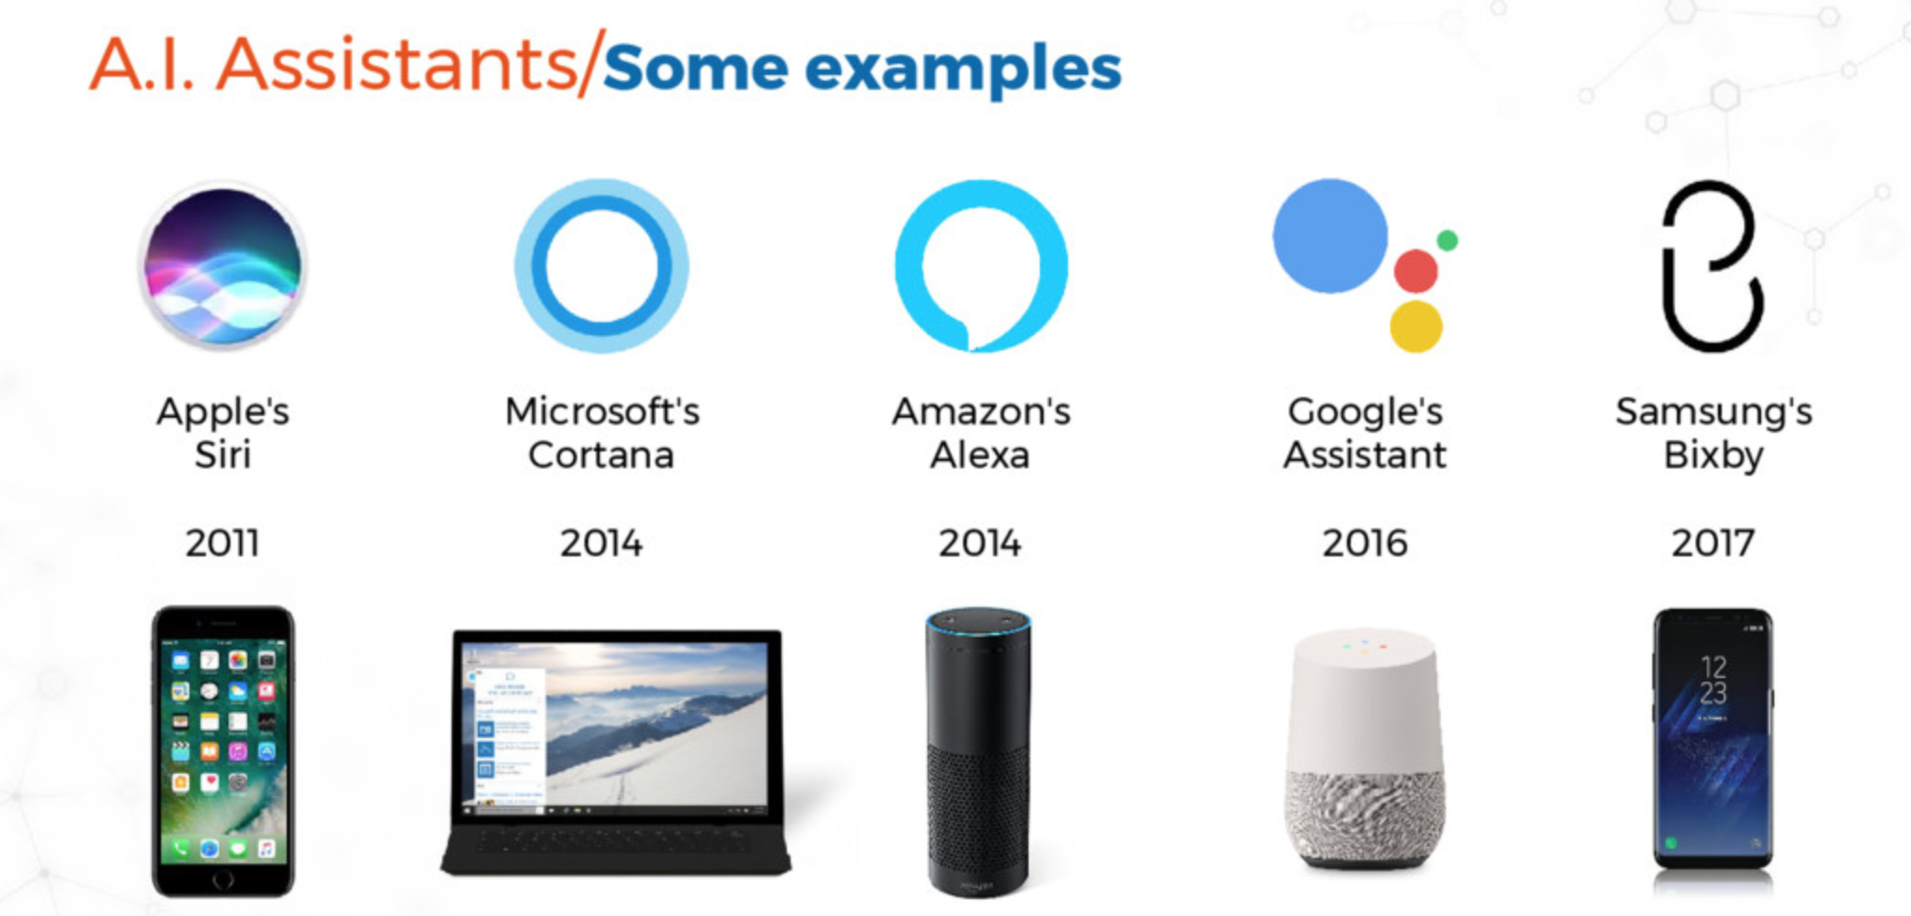

Slide 6
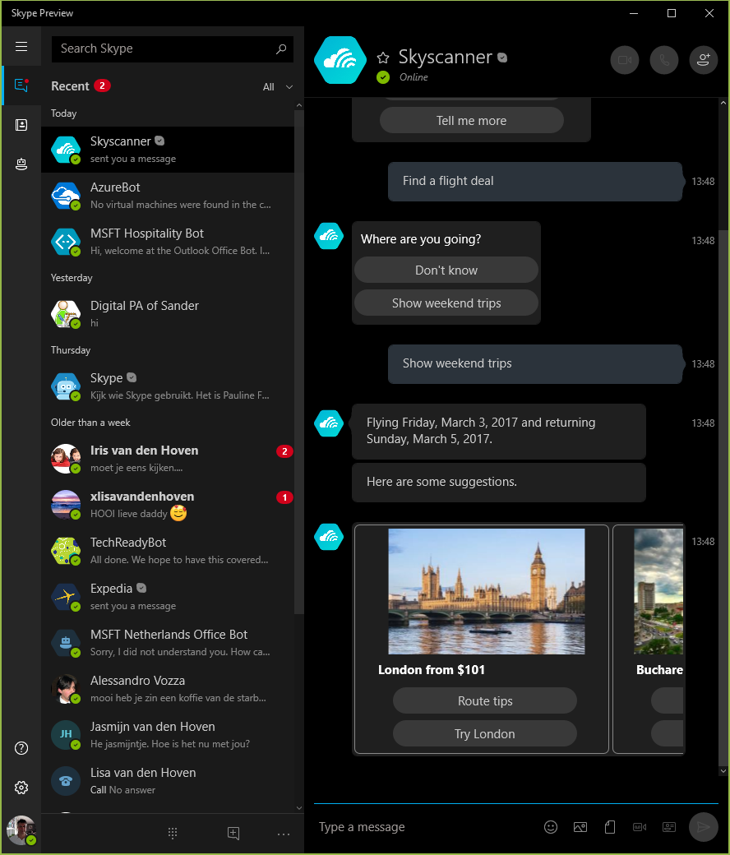
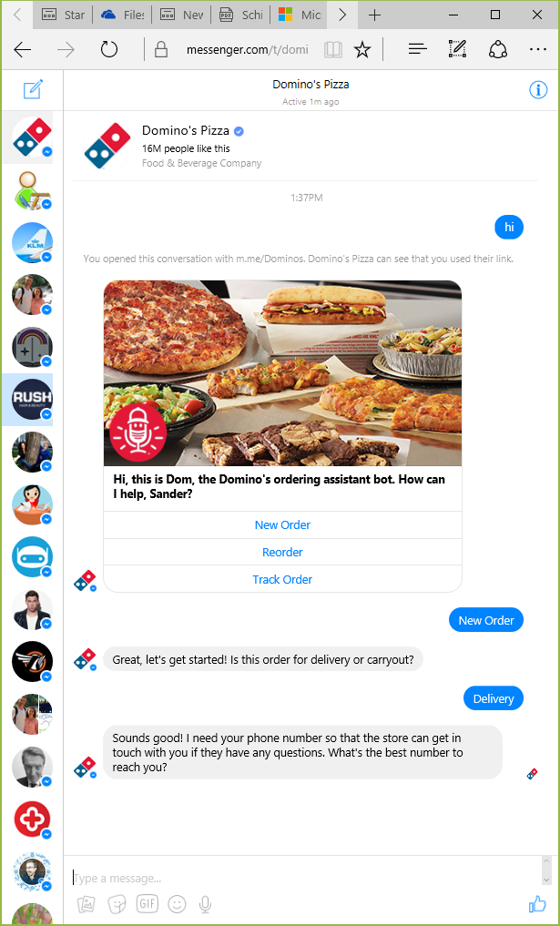
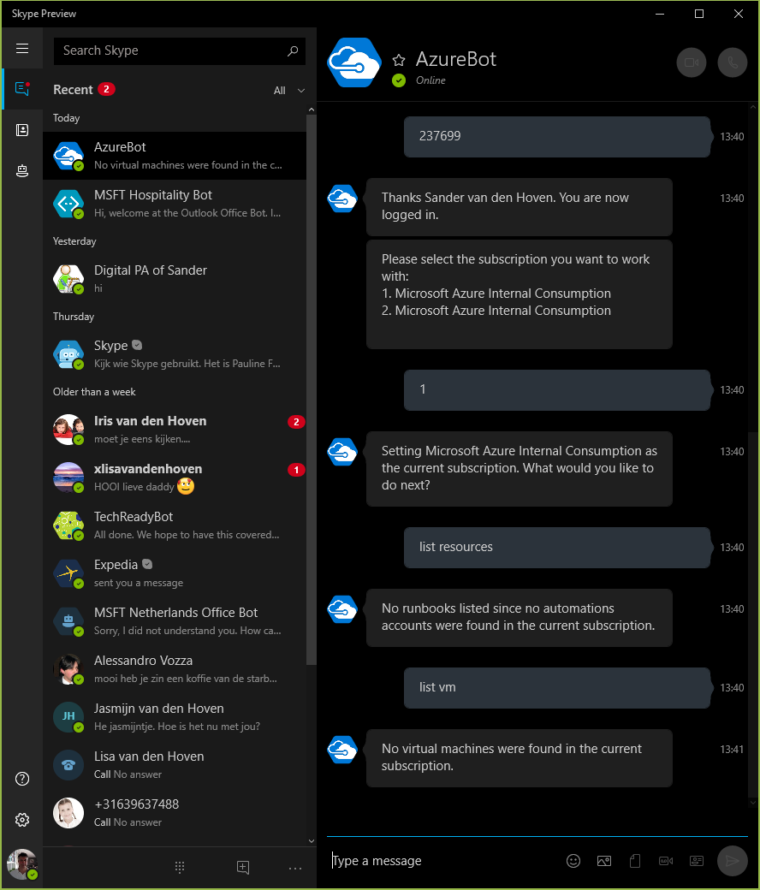
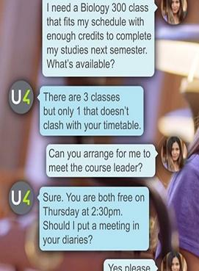
Bot Examples

Slide 7
How developers like us are using it

Slide 8
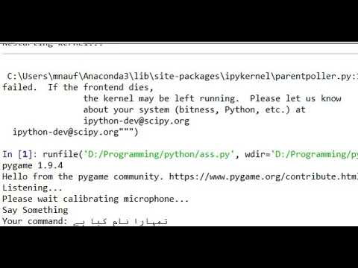
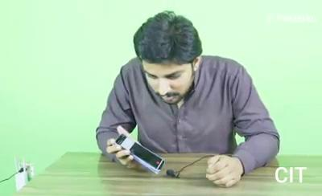
How developers like us are using it

Slide 9

Speech to Text Libraries/APIs
Google Speech API IBM Watson API SpeechAPI Speech to Text API Text-to-Speech API Rev.AI API ReadSpeaker API Speech2Topics API

Slide 10

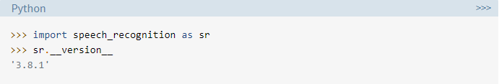
Installation and Importing

Slide 11

Recognizer Instance
The primary purpose of a Recognizer instance is, of course, to recognize speech. Each instance comes with a variety of settings and functionality for recognizing speech from an audio source.

Slide 12
Recognizer Instance methods
Each Recognizer instance has seven methods for recognizing speech from an audio source using various APIs. These are:
recognize_bing(): Microsoft Bing Speech
recognize_google(): Google Web Speech API
recognize_google_cloud(): Google Cloud Speech - requires installation of the google-cloud-speech package
recognize_ibm(): IBM Speech to Text
recognize_sphinx(): CMU Sphinx - requires installing PocketSphinx

Slide 13

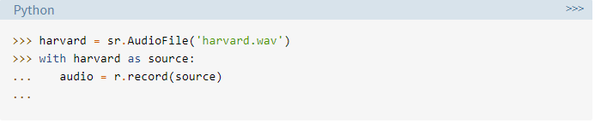
Using record() to Capture Data From a File

Slide 14
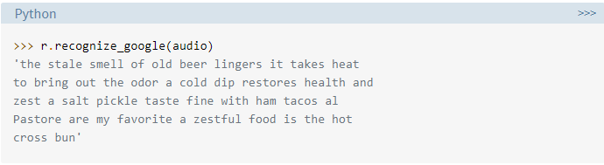
Audio file to Text

Slide 15

Microphone to Text? Install dependency
git clone https://github.com/mnauf/pycon-speech-applications.git
pip install PyAudio-0.2.11-cp37-cp37m-win_amd64.whl
Testing Installation

Slide 16
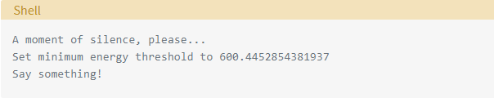
Make sure your default microphone is on and unmuted. If the installation worked, you should see something like this:

Slide 17

Microphone Instance
Instead of

Slide 18
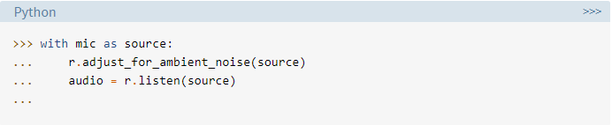
Using listen() to Capture Microphone Input

Slide 19
2 Projects

Slide 20
Project 1
I'm thinking of one of these words: apple, banana, grape, orange, mango, lemon You have 3 tries to guess which one.
Guess 1. Speak! You said: banana Incorrect. Try again.
Guess 3. Speak! You said: Orange Correct! You win!

Slide 21
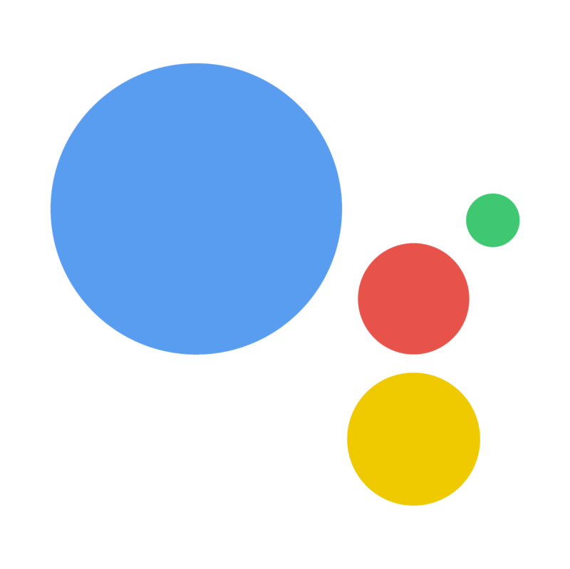
Project 2
Make your own digital personal assistant.

Slide 22
Acknowledgement
Some slides are taken from PIAIC IOT slides.

Slide 23



Let’s get connected
/muhammad.naufil
/in/muhammad-naufil-0554a5166
/mnauf

